Slide 1
LESSON PLAN
DATE: the 15th of December 2017
SCHOOL: Technical College , Târnăveni
TEACHER: Mihăilescu Luminița Mariana
FORM: 9th B
LEVEL: Intermediate
TEXTBOOK: Going for Gold
LESSON: A DREAM COME TRUE?
TYPE OF LESSON: practising on new information
GENERAL COMPETENCES: -reading and listening comprehension, speaking
SPECIFIC COMPETENCES: (1.1, 1.2, 1.3,1.5, 2.1, 3.1, 4.3)
Communicative and Pragmatic Competence- Producing oral messages and interactions ( Spoken Interaction)
Communicative Competence– Receiving written messages ( Reading)
Communicative Competence– Receiving oral messages ( Listening)
Communicative and Pragmatic Competence – Producing written messages and interactions ( Writing)
LESSON AIMS:
-to provide oral practice and to encourage conversation based on an assigned topic;
-to encourage the students to look for information and bring their own arguments to support their answers;
-to stimulate conversation, to create interest in the topic and to initiate discussion;
-to give the students a chance to practice their reading and speaking skills;
SKILLS INVOLVED: speaking, reading, listening, writing
METHODS: conversation, explanation, interactive method: double bubble
MATERIALS: whiteboard, videoprojector, posters, worksheets, textbook, laptop

Slide 2

A DREAM COME TRUE?

Slide 3
STAGES AND TECHNIQUES
STAGE | TEACHER’S ACTIVITY | STUDENT’S ACTIVITY | INTERACTION | SKILLS | TIME
Warm up | The teacher -greets the students -calls the rolls. - creates a friendly atmosphere | The students -answer the teacher’s greeting - prepare for the lesson | Teacher-students | speaking | 2’
Checking the previous knowledge | -Asks questions about the previous lesson -Checks homework -asks students to choose the qualities of a good friend | -answer the questions -read their homework (powerpoint presentations)- in pair of two, students complete the task | Teacher-students Student-student | Speaking reading | 5’

Slide 4
Introducing new topic | -creates a connection between the previous lesson and the new lesson through a warm up activity - presents students a short video about the life story of David and Victoria Beckam - anounces the title of the new lesson „Dream On” -elicits the meaning - asks students about their future dreams and ambitions | - answer the questions -Watch the video -write the title in their notebooks - talk about their future dreamsand ambitions | Teacher-students | Speaking Writing Listening | 8’

Slide 5
Pre-reading activity | -explains the meaning of new words and phrases -asks students to match the new words with their meaning and complete the sentences with the new words -checks the exercises | - do the exercises on their worksheet - read the exercises | Teacher-students | Speaking Reading writing | 8’
Reading | -Asks students to read the lesson and ckecks their pronounciation | -Read the lesson -Complete the text with the missing information | Teacher-student | Reading speaking | 12’

Slide 6
Post-reading activity | Asks students questions about the text and writes the information in the right bubble (double bubble method) Asks students to notice the similarities and differencies between these two stars | -complete the worksheets with the mising information - answer the teacher’s questions | Teacher-students | Reading Speaking Writing | 8’
Follow Up | -Announces students they will watch the first part of a video – an interview with Victoria Beckam about the secrets of her success | - watch the video -write down the ideas | Teacher-students | Listening speaking | `5’
Homework | Homework: to watch the rest of the interview and write down the steps to success | -write down their homework | Teacher-students | Writing | 2’

Slide 7
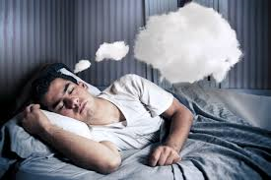
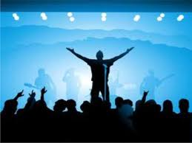
DREAM
-a sequence of scenes and feelings occuring in the mind while sleeping
Ex. Good night! Sweet dreams!
-an ambition or ideal, especially when it is not very realistic
Ex. My dream is to become a famous singer.

Slide 8
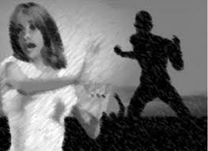
Verb: PHRASE:
DREAM-DREAMT/DREAMED-DREAMT/DREAMED
DREAM ON
to have a dream.
to see or imagine in sleep or in a vision: ex. We dream all sorts of dreams.
I dreamed that a monster was chasing me.
I dreamed of you last night.
If you tell someone to dream on, you mean that something they are hoping for is unlikely to happen.
Ex. I think my band will be famous one day." "Dream on.“

Slide 9

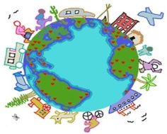
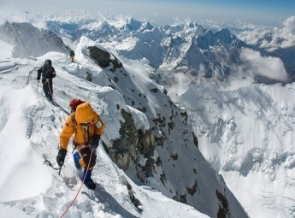
Expressing dreams, hopes, ambitions
One day........
Examples:
I’d like to........
My dream is to....
I’m thinking of... +Ving
I’m considering...
+Ving
I’d like to become a teacher.
My dream is to travel around the world.
I’m thinking of climbing the Everest.

Slide 10
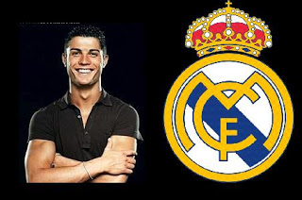
NEW WORDS
DEBUT
-the first time that a performer/ player performs in public
Ex. The football player, Ronaldo, made his senior international debut in August 2003, at the age of 18.

Slide 11
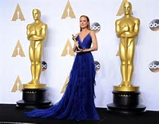
TO BURST ONTO
-to arrive suddenly, with a lot of energy
Ex. She's been acting for years, but now that she's been nominated for an Academy Award, she's really burst onto the scene.

Slide 12
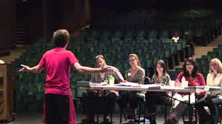
AUDITION
a short performance given by an actor, a singer, a musician to test whether he or she is suitable for a particular role
Ex. Why don't you go along to the auditions for the school play? You're a good actor.

Slide 13
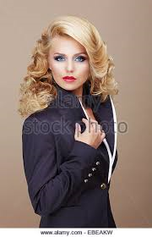
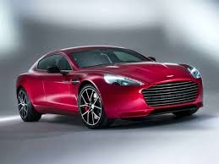
POSH
elegant and
expensive; smart
Ex. She's got a very posh car.

Slide 14
DEBUT
-the first time that a performer/ player performs in public
Ex. The football player, Ronaldo, made his senior international debut in August 2003, at the age of 18
TO BURST ONTO
-to arrive suddenly, with a lot of energy
Ex. She's been acting for years, but now that she's been nominated for an Academy Award, she's really burst onto the scene
AUDITION
a short performance given by an actor, a singer, a musician to test whether he or she is suitable for a particular role
Ex. Why don't you go along to the auditions for the school play? You're a good actor.
POSH
elegant and
expensive; smart
Ex. She's got a very posh car

Slide 15
DREAM ON
-Worksheet-
1. Match the new words with their meanings: debut burst onto audition posh
- a short performance given by an actor, a singer, a musician to test whether he or she is suitable for a particular role -........................................
- the first time that a performer player performs in public - ......................................
- elegant and expensive, smart - ..............................
- arrive suddenly, with a lot of energy - ..............................
2. Complete the sentences with the missing words from exercise 1:
A major new talent .................................the scene last week.
You look very .............................in this suit.
Ed Sheeran’s .............................album was an international best seller.
She flew to London to .....................................for the leading role of Juliet.

Slide 16


